Slide 1
IOS Fundamentals & UIkit
Subtitle 24pt Arial
Nhan Phan
EMB Nov,2022

Slide 2
Agenda
Application Architecture
Application Lifecycle
View Controller Lifecycle
Model-View-Controller
Navigation

Slide 3
Application Architecture
Structure of a UIApplication
Model-View-Controller in OS
Models
Views
View Controllers
TEXT EXAMPLE
update view with new state
state change
Model
View Controller
View
handle event
by updating model
interpret and propagate event

Slide 4
Application Lifecycle
State Changes in an IOS app
Not running
Inactive
Active
Background
Suspended
The application delegate
The scene delegate
TEXT EXAMPLE
Not running
Foreground
Inactive
Active
Background
Background
Suspended

Slide 5
View Controller Lifecycle
Init(coder:)
Init(nibNam:bundle)
Loadview
Viewdidload
viewWillAppear
viewWillLayoutSubViews
viewDidAppear
viewWilDisappear
viewDidDisapear
Deinit
didReceiveMemoryWarning
loadView
TEXT EXAMPLE
viewDidLoad
viewWillAppear
viewDidAppear
viewWillDisappear
viewDidDisappear
didRecieveMemoryWarming

Slide 6

Cocoapods
Install Cocoapods
Sudo gem install cocoapods
Create Podfile
pod init
Add dependency
pod ’Alamofire’,’4.9.1’
Install dependency
pod install
TEXT EXAMPLE

Slide 7
Uikit Essentials
Create model
Configure the collection as a list
Configure the data source
Apply a snapshot

Slide 8
Model-View-Controller
Keep text minimal
Minimum bulleted text size is 14pt
Find brand, business, industry photography and more on the Image Library in the Brand Assets section on the Brand Portal
View in slideshow mode to activate link
TEXT EXAMPLE

Slide 9
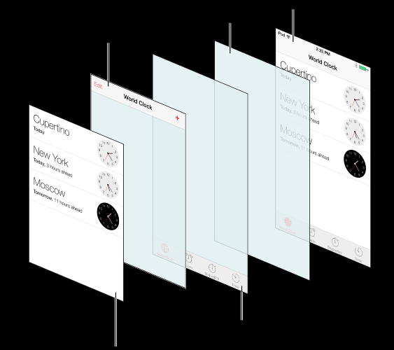
Navigation
Keep text minimal
Minimum bulleted text size is 14pt
Find brand, business, industry photography and more on the Image Library in the Brand Assets section on the Brand Portal
View in slideshow mode to activate link
TEXT EXAMPLE

Slide 10
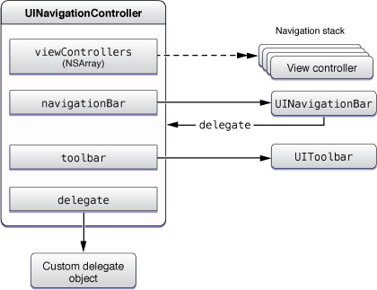
Navigation
https://fxstudio.dev/basic-ios-tutorial-navigation-controller/
TEXT EXAMPLE

Slide 11
Table Views
TEXT EXAMPLE

Slide 12
Data sources
TEXT EXAMPLE

Slide 13
Editable cells
TEXT EXAMPLE

Slide 14
Thank You

Slide 16
Recommended Graphic Styles
THEME COLORS AND GRADIENTS
HIGHLIGHT COLOR USAGE AND GRAPHIC ELEMENTS
Introducing deep blue!
Although it is very dark and may appear almost black, it adds great depth when used in large areas and backgrounds, as shown in the title and divider slides.
Less is more.
There are 3 new colors to highlight important elements or to add additional colors to charts and graphs. These aren’t meant to be used as background colors or for large areas.
DEEP BLUE
DEEP BLUE TO BLACK GRADIENT
Arrows and lines

Slide 17
PowerPoint Assets (View in Slideshow Mode to Activate Links in this Presentation)
We are currently updating our Brand Portal so please check back for updated versions of the following resources:
Additional Cover and Divider Slides
PowerPoint Icon Library
PowerPoint Diagram Library
Questions? Email us at brand@HitachiVantara.com

Slide 18
Bullet Slide Example 24pt Arial Bold
First-level bullet copy is 20pt Arial
Levels of bullets should have a 2pt difference
Minimum bulleted text size is 14pt
Try not to exceed 6 bullet points on a slide
Bulleted copy should be sentence case
Do not use punctuation within bulleted text
Use Arial bold and color to highlight text

Slide 19
Confidential Slide Example 24pt Arial Bold Subtitle Example 18pt Arial Regular
First-level bullet copy is 20pt Arial
Levels of bullets should have a 2pt difference
Minimum bulleted text size is 14pt
Try not to exceed 6 bullet points on a slide
Bulleted copy should be sentence case
Use Arial bold and color to highlight text
NOTE
If the full presentation is internal or confidential, every slide must include a confidentiality statement.

Slide 20
Photo and Text Slide Example
Keep text minimal
Minimum bulleted text size is 14pt
Find brand, business, industry photography and more on the Image Library in the Brand Assets section on the Brand Portal
View in slideshow mode to activate link
TEXT EXAMPLE

Slide 21





Photo and Icon Slide Example
MAIN POINT
MAIN POINT
MAIN POINT
NOTE
On interior image background slides, image should align below (orange) template guideline. Make sure ”Guides” is selected under “View” in PowerPoint.
© Hitachi Vantara LLC 2020. All Rights Reserved.

Slide 22




Icons and Text Example
Keep text minimal
Combine icons and symbols to convey ideas visually
Find a PowerPoint file of all icons on the Templates section of the Brand Portal
View in slideshow mode to activate link

Slide 23

Text and Quote or Callout Example
Two styles for highlighting key text or quotes with callout boxes
The top option works best for plain text
Use the bottom option if you include a logo
Keep text minimal
Minimum bulleted text size is 14pt
Insert your quotation or callout text in this box. Use Arial white text with a minimum size of 14pt.
– Source attribution
Insert your quotation or callout text in this box. Use Arial white text with a minimum size of 14pt.
– Source attribution

Slide 24
Divider Slide Sample

Slide 25
Divider Slide Sample

Slide 26
Divider Slide Sample

Slide 27
Agenda Example
First Topic
Second Topic
Third Topic
Fourth Topic
Fifth Topic

Slide 28
Matrix Example
 | MAY | JUNE | JULY
WEEK | 1 2 3 4 5 6 7 8 9 10 11 12 13
TASK 1
TASK 2
TASK 3
TASK 4
TASK 5

Slide 29
Map Example
45%
12%
28%
DATA CALLOUT
DATA CALLOUT
DATA CALLOUT

Slide 30
Diagram Slide Example
Use diagrams with text on on their own to communicate abstract ideas
Download examples of diagrams from the Templates section of the Brand Portal
View in slideshow mode to activate link
Sub
Point
Sub
Point
Sub
Point
MAIN POINT
Sub
Point
Sub
Point
Sub
Point

Slide 31
Table Example
 | HEADER EXAMPLE All capS | Arial | 16PT BOLD WHITE
FIRST ROW EXAMPLE | Arial | Table body copy should be sentence case | Optional bullet text Highlight bold with color
Arial 16PT BOLD | Minimum font size is 14pt | Tables should be concise and easy to read | Subtext Subtext Subtext
Headers should be All capitals | Do not fill the cells with too much information |  | Subtext

Slide 32
Bar Chart Example
NOTE
PPT CHARTS To preserve the chart style, right click on the chart and choose Edit Data. Type or paste your data into the linked spreadsheet.
SOURCE: DATA

Slide 33
Line Chart Example
SOURCE: DATA

Slide 34
Pie Chart Example
SOURCE: DATA

Slide 35
Thank You

